Slide 1
AMPERE’S LAW

Slide 2
DEFINITION:
This law states that the dot product of flux density B and small length ∆L around any closed path is equal to µ. times the total current enclosed by the path .

Slide 3

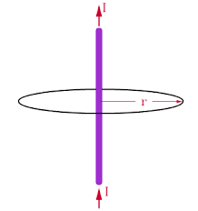
METHAMETICAL FORMULA : FIGURE:

Slide 4
EXPLANATION:
Consider the magnetic field around the straight current carrying conductor .The strength of this magnetic field B is constant on a circle of radius r. this strength of magnetic field B around the current carrying conductor is directly proportional to current in conductor and inversely proportional to the radial distance r from the conductor.

Slide 5

Mathematically:
B∞I …..1
B ∞1/r …..2
combining (1) & (2)
B ∞I/r
Where µ◦/2π is constant of proportionality and µ◦ is constant of the free space called permittivity ,the value of which for free space is 4π*10-7 Wb/Am

Slide 6
Applications of Ampere's law
1: Magnetic field due to current in the straight conductor 2: Magnetic field due to current carrying solenoid
3:Magnetic force on moving charges

Slide 7
Magnetic field due to current in the straight conductor
This equation gives us information about the magnetic field due to current in the straight conductor

Slide 8
Amperian path: The closed path in the form of circle of radius r enclosing the current carrying wire is called Amperian path.
Divide this Amperian path in small elements of lengths
∆L1. ∆L2. ∆L3 -------- ∆Ln

Slide 9
Let the magnetic field at these elements be B1.B2.B3 -------- Bn So B1. ∆L1 = B1 ∆L1Cos(0) = B1 ∆L1 B2. ∆L2 = B2 ∆L2Cos(0) = B2 ∆L2 B3. ∆L3 = B3 ∆L3Cos(0) = B3 ∆L3 Bn. ∆Ln = Bn ∆LnCos(0) = Bn ∆Ln

Slide 10
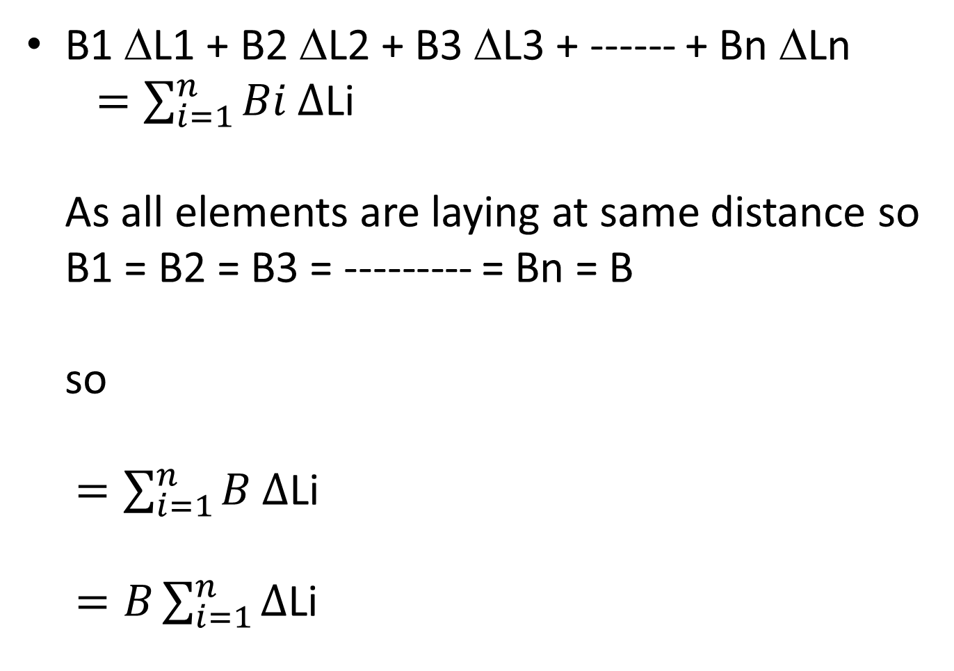
B1 ∆L1 + B2 ∆L2 + B3 ∆L3 + ------ + Bn ∆Ln $=\sum_{i=1}^{n}{Bi ∆\text{L}\text{i}}$ As all elements are laying at same distance so B1 = B2 = B3 = --------- = Bn = B so $=\sum_{i=1}^{n}{B ∆\text{L}\text{i}}$ $=B\sum_{i=1}^{n}{∆\text{L}\text{i}}$

Slide 11
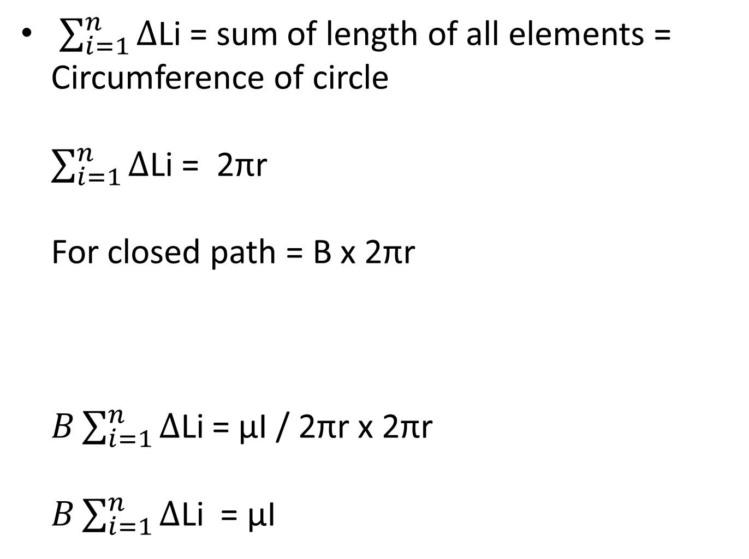
$\sum_{i=1}^{n}{∆\text{L}\text{i}}$ = sum of length of all elements = Circumference of circle $\sum_{i=1}^{n}{∆\text{L}\text{i}}$ = 2πr For closed path = B x 2πr $B\sum_{i=1}^{n}{∆\text{L}\text{i}}$= µI / 2πr x 2πr $B\sum_{i=1}^{n}{∆\text{L}\text{i}}$ = µI

Slide 12
So
This is Ampere’s Circuital law for special case of circular path

Slide 13
Magnetic field due to current carrying solenoid
Consider a rectangular amperian path abcd in the field of solenoid
This rectangular path is divided into four elements of length i.e. l1 ,l2 ,l3 and l4
In order to calculate the magnetic field ,due to the current in a solenoid ,we can use ampere’s circuital law

Slide 14
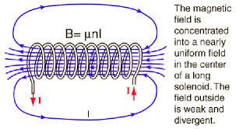
What will be
The magnetic field at the middle of the solenoid?
The magnetic field at the turns?
The magnetic field out side the solenoid?

Slide 15
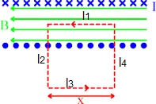
Applying Circuital law
--------eq(1)
Where the magnetic field is constant and ∆L = l1 + l2 + l3 + l4 The length l1 is along the direction of the magnetic field so B.l1 = Bl1Cos(0) = Bl1 B.l2 = Bl2Cos(90) = 0 (l2 is normal to B)
B.l3 = Bl3Cos(180) = 0 (B is out side solenoid)
B.l4 = Bl4Cos(90) = 0 (l4 is normal to B)

Slide 16
By putting all these values in eq(1) we get Bl1 + 0 + 0 + 0 = µI Bl1 = µ x total current -----eq(2)
Let there be N number of turns in the length l1 of solenoid and in each turn the current is I total current = NI
Let n be the number of turn per unit length l1 n = N/l1
Total current becomes nl1i

Slide 17
Now the eq(2) becomes Bl1 = µnl1I B = µnI
So this eq give the magnetic field due to the current in solenoid
Its direction can be determined by right hand rule
The curling fingers shows the direction of the current while the thumb points in the direction of the magnetic field.

Slide 18

References:
Hyperphysics.phy-astr.gsu.edu
Wikipedia.org
Farside.ph.utaxas.edu
Youtube.com/watch?v=ryGzpGpTtlM
OR write in youtube AMPERES LAW(PART 1)

